Slide 1
LC-3 Datapath

Slide 2
Wires (or lines)
1 wire
2 wires
2
4 wires
4

Slide 3
Gate
Z means high impendence, effectively blocking the flow of electrons (closes the gate)
A
A
Z
1
0

Slide 4
Bus
A₀
Wires
A₁
A₂
A₃
1
0
0
A[3:0]
B[3:0]
C[3:0]

Slide 5
Bus
B₀
Wires
B₁
B₂
B₃
0
1
0
A[3:0]
B[3:0]
C[3:0]

Slide 6
Bus
C₀
Wires
C₁
C₂
C₃
0
0
1
A[3:0]
B[3:0]
C[3:0]

Slide 7
Sign Extension
Still 170
Extend the length of a bit string, while maintaining its value and signedness
Sign extend +ve number
0 | 0 | 0 | 0 | 0 | 0 | 0 | 0 | 1 | 0 | 1 | 0 | 1 | 0 | 1 | 0
Still -170
Sign extend -ve number
1 | 1 | 1 | 1 | 1 | 1 | 1 | 1 | 0 | 1 | 0 | 1 | 0 | 1 | 1 | 0

Slide 8
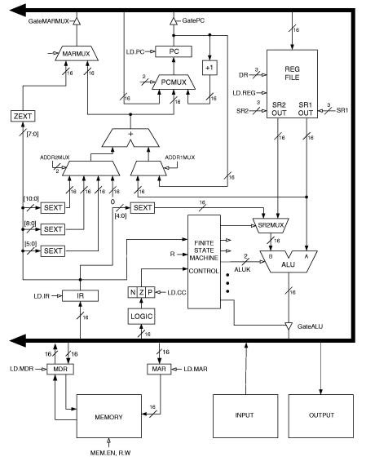
0
Fetch
Assert GatePC
Assert LD.MAR
Assert MEM.EN & R
Assert LD.MDR
Deassert GatePC Assert GateMDR
Assert LD.IR
1
1
1
1

Slide 9
ADD (register mode)
DR <= (SR1) + (SR2)
SR2MUX select SR2OUT
ALUK selects ADD
Assert GateALU
LD.REG
1
Contents of IR
opcode |  |  |  | dr |  |  | sr1 |  |  | m | Unused |  | sr2
0
0
0
1
0
0
1
0
1
0
0
0
0
0
1
1
1

Slide 10
ADD (immediate mode)
DR <= (SR1) + SEXT(IR[4:0])
SR2MUX select SEXT(IR[4:0])
ALUK selects ADD
Assert GateALU
LD.REG
1
Contents of IR
opcode |  |  |  | dr |  |  | sr1 |  |  | m | imm5 |  | sr2
0
0
0
1
0
0
1
0
1
0
1
0
0
0
1
1
1

Slide 11
AND (register mode)
DR <= (SR1) bitwise and (SR2)
SR2MUX select SR2OUT
ALUK selects AND
Assert GateALU
LD.REG
1
Contents of IR
opcode |  |  |  | dr |  |  | sr1 |  |  | m | Unused |  | sr2
0
1
0
1
0
0
1
0
1
0
0
0
0
0
1
1
1

Slide 12
AND (immediate mode)
DR <= (SR1) bitwise and SEXT(IR[4:0])
SR2MUX select SEXT(IR[4:0])
ALUK selects AND
Assert GateALU
LD.REG
1
Contents of IR
opcode |  |  |  | dr |  |  | sr1 |  |  | m | imm5 |  | sr2
0
1
0
1
0
0
1
0
1
0
1
0
0
0
1
1
1

Slide 13
NOT
DR <= bitwise not (SR1)
ALUK selects NOT
Assert GateALU
LD.REG
1
Contents of IR
opcode |  |  |  | dr |  |  | sr1 |  |  | unused | imm5 |  | sr2
1
0
0
1
0
0
1
0
1
0
1
1
1
1
1
1
1

Slide 14
LEA
DR <= (PC) + SEXT(IR[8:0])
ADDR1MUX selects PC
ADDR2Mux selects SEXT(IR[8:0])
MARMUX selects ADDR ADD
GateMARMUX
LD.REG
1
ADDR ADD
1
SECT(IR[8:0])
PC
Contents of IR
opcode |  |  |  | dr |  |  | PCOffset9 |  |  | unused | imm5 |  | sr2
1
1
1
0
0
0
1
0
1
0
1
1
1
1
1
1

Slide 15
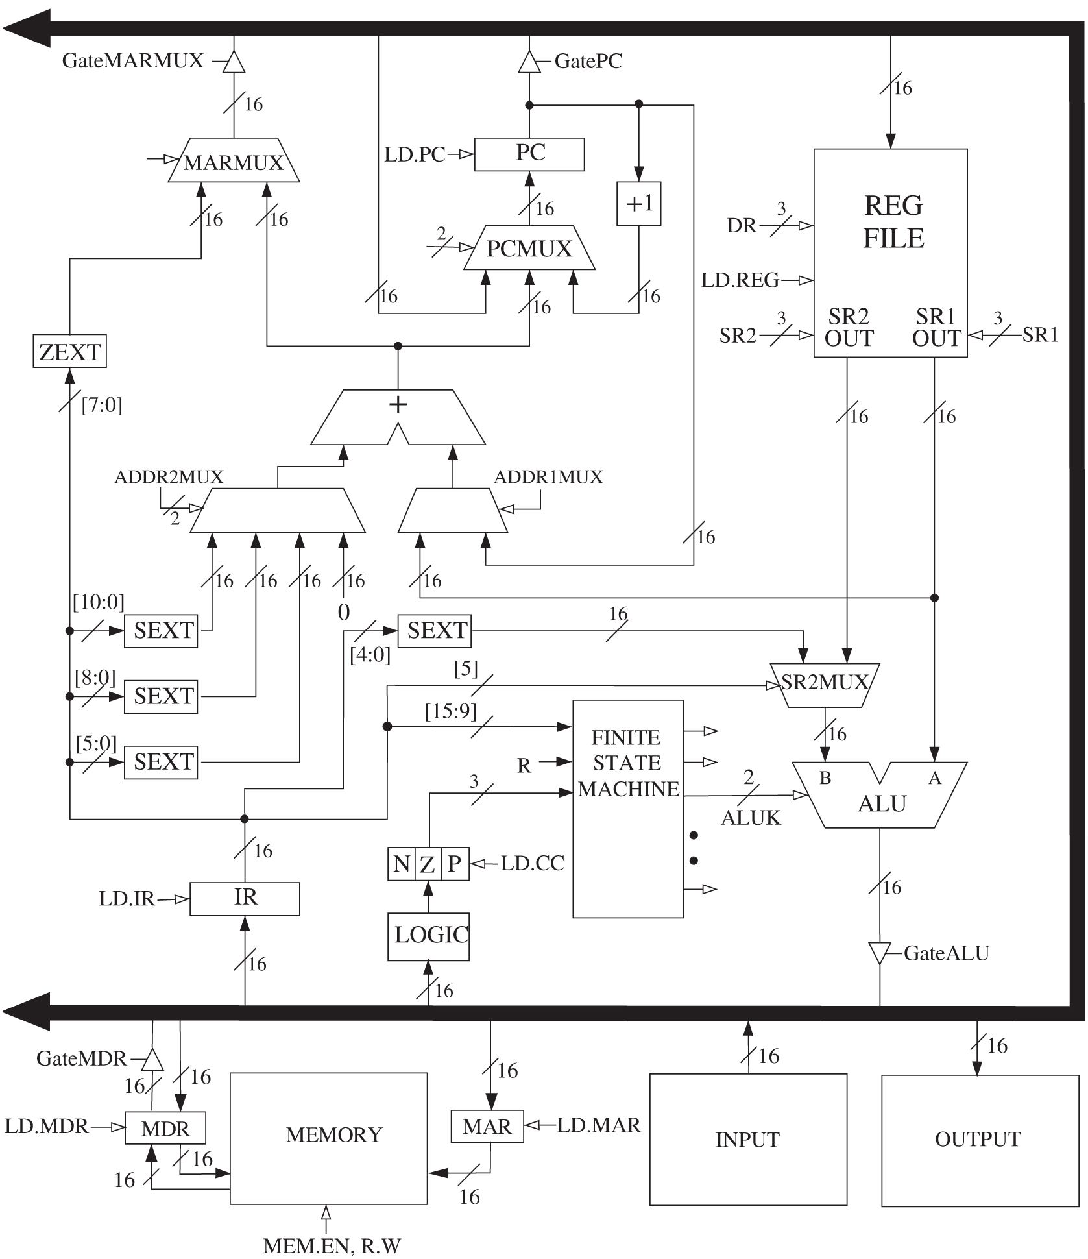
LD
DR <= Mem[(PC) + SEXT(IR[8:0])]
ADDR1MUX selects PC
ADDR2Mux selects SEXT(IR[8:0])
MARMUX selects ADDR ADD
GateMARMUX
Assert LD.MAR
Assert MEM.EN & R
Assert LD.MDR
Assert Gate.MDR
Assert LD.REG
1
ADDR ADD
1
SECT(IR[8:0])
PC
Contents of IR
opcode |  |  |  | dr |  |  | PCOffset9 |  |  | unused | imm5 |  | sr2
0
0
1
0
0
0
1
0
1
0
1
1
1
1
1
1
1
1
1

Slide 16
LDI
DR <= Mem[Mem[(PC) + SEXT(IR[8:0])]]
ADDR1MUX selects PC
ADDR2Mux selects SEXT(IR[8:0])
MARMUX selects ADDR ADD
GateMARMUX
Assert LD.MAR
Assert MEM.EN & R
Assert LD.MDR
Assert Gate.MDR
Assert LD.MAR
Assert MEM.EN & R
Assert LD.MDR
Assert Gate.MDR
Assert LD.REG
1
1
1
SEXT(IR[8:0])
1
Contents of IR
opcode |  |  |  | dr |  |  | PCOffset9 |  |  | unused | imm5 |  | sr2
1
0
1
0
0
0
1
0
1
0
1
1
1
1
1
1
1
1
1

Slide 17
LDR
DR <= Mem[(BaseR) + SEXT(IR[5:0])]
ADDR1MUX selects (IR[8:6])
ADDR2Mux selects SEXT(IR[5:0])
MARMUX selects ADDR ADD
GateMARMUX
Assert LD.MAR
Assert MEM.EN & R
Assert LD.MDR
Assert Gate.MDR
Assert LD.REG
1
ADDR ADD
1
SEXT(IR[8:0])
(IR[8:6])
Contents of IR
opcode |  |  |  | dr |  |  | BaseR |  |  | Offset6 | Unused |  | sr2
0
1
1
0
0
0
1
0
1
0
1
1
1
1
1
1
1
1
1

Slide 18
ST
Mem[(PC) + SEXT(IR[8:0])] <= SR
ADDR1MUX selects PC
ADDR2Mux selects SEXT(IR[8:0])
MARMUX selects ADDR ADD
GateMARMUX
Assert LD.MAR
SR1MUX (not shown) selects IR[11:0]
ALUK selects Pass Through
Assert GateALU
Assert LD.MDR
Assert MEM.EN & W
1
ADDR ADD
SEXT(IR[8:0])
PC
Contents of IR
opcode |  |  |  | sr |  |  | PCOffset9 |  |  | unused | imm5 |  | sr2
1
0
0
1
1
0
0
1
0
1
0
1
1
1
1
1
1
1
1

Slide 19
STI
Mem[Mem[(PC) + SEXT(IR[8:0])]] <= SR
ADDR1MUX selects PC
ADDR2Mux selects SEXT(IR[8:0])
MARMUX selects ADDR ADD
GateMARMUX
Assert LD.MAR
Assert MEM.EN & R
Assert LD.MDR
Assert Gate.MDR
Assert LD.MAR
SRC1MUX (not shown) selects IR[11:9]
ALUK selects Pass Through
Assert GateALU
Assert LD.MDR
Assert MEM.EN & W
1
ADDR ADD
SEXT(IR[8:0])
PC
1
Contents of IR
opcode |  |  |  | dr |  |  | PCOffset9 |  |  | unused | imm5 |  | sr2
1
1
0
1
1
0
0
1
0
1
0
1
1
1
1
1
1
1
1

Slide 20
STR
Mem[(BaseR) + SEXT(IR[5:0])] <= SR
ADDR1MUX selects (IR[8:6])
ADDR2Mux selects SEXT(IR[5:0])
MARMUX selects ADDR ADD
GateMARMUX
Assert LD.MAR
SR1MUX selects IR[11:9] ​(not shown)
ALUK selects Pass Through
Gate.ALU
MDRMUX selects Bus ​(not shown)
LD.MDR
MEM.EN/W
1
ADDR ADD
SEXT(IR[5:0])
(IR[8:6])
Contents of IR
opcode |  |  |  | sr |  |  | BaseR |  |  | Offset6 | Unused |  | sr2
0
1
1
1
0
0
1
0
1
0
1
1
1
1
1
1
1
1
1
1

Slide 21
JMP
PC <= (BaseR)
ADDR1MUX selects SRC1OUT
ADDR2Mux selects 0
PCMUX selects ADDR ADD
LD.PC
1
ADDR ADD
Selects 0
SRC1OUT
Contents of IR
opcode |  |  |  | Unused |  |  | BaseR |  |  | Unused | Unused |  | sr2
1
1
0
0
0
0
0
0
1
0
0
0
0
0
0
0

Slide 22
BR
PC <= (PC) + SEXT(IR[8:0]) iff (N.n + Z.z + P.p)
ADDR1MUX selects PC
ADDR2Mux selects SEXT(IR[8:0])
PCMUX selects ADDR ADD
LD.PC iff (N.n + Z.z + P.p)
N.n+Z.z+P.p
Addr ADD
SEXT(IR[8:0])
PC
Contents of IR
opcode |  |  |  | n | z | p | PCOffset9
1
1
1
0
0
0
1
0
1
0
1
1
1
1
1
1

Slide 23
JSR
R7 <= (PC)
PC <= (PC) + SEXT(IR[8:0])
GatePC
DRMUX selects [111]
LD.REG
ADDR1MUX selects PC
ADDR2Mux selects SEXT(IR[8:0])
PCMUX selects ADDR ADD
LD.PC
1
1
Addr ADD
1
SEXT(IR[8:0])
PC
Contents of IR
opcode |  |  |  | m | PCOffset11
0
1
0
0
1
0
1
0
1
0
1
1
1
1
1
1

Slide 24
JSRR
R7 <= (PC)
PC <= (BaseR)
GatePC
DRMUX selects [111]
LD.REG
ADDR1MUX selects SRC1OUT
ADDR2Mux selects 0
PCMUX selects ADDR ADD
LD.PC
1
1
Addr ADD
1
Select 0
SRC1OUT
Contents of IR
opcode |  |  |  | m | unused |  | BaseR |  |  | unused
0
1
0
0
0
0
0
0
1
0
0
0
0
0
0
0

Slide 25
TRAP
R7 <= (PC)
PC <= MEM[ZEXT(IR[7:0])]
GatePC
DRMUX selects [111]
LD.REG
MARMUX selects ZEXT(IR[7:0])
GateMARMUX
Assert LD.MAR
Assert MEM.EN & R
Assert LD.MDR
Assert Gate.MDR
PCMUX selects bus
LD.PC
1
1
ZEXT(IR[7:0])
1
bus
1
Contents of IR
opcode |  |  |  | unused |  |  | trapvec8
1
1
1
1
0
0
0
0
0
0
0
1
0
1
0
1
1
1
1

